Slide 1

Oracle Mobile & Intelligent Bots
Build Better Apps Faster
Ed Shnekendorf, AppDev/IaaS Architect
John Dwyer, AppDev/IaaS Account Manager
Sri Sundaresan, Enterprise Cloud Architect
Andrew Holland, Cloud Platform Account Manager
February 2018

Slide 2
Key Challenges:
Loans that are out-of-policy require back-and-forth communication between dealer F&I contacts and PenFed Loan Processors
CUDL does not provide any active notification capabilities and often messages sit for hours or days.
This results in delayed funding of loans causing brand damage to PenFed and increases risk of losing customers
Solution:
Enable a “sideband” notification channel for dealers and PenFed to communicate using the latest in cloud-based & mobile technologies
Business Value:
Reduce or eliminate funding delays due to lack of message awareness
Provide a temporary solution until CUDL can be replaced with a new system

Slide 3
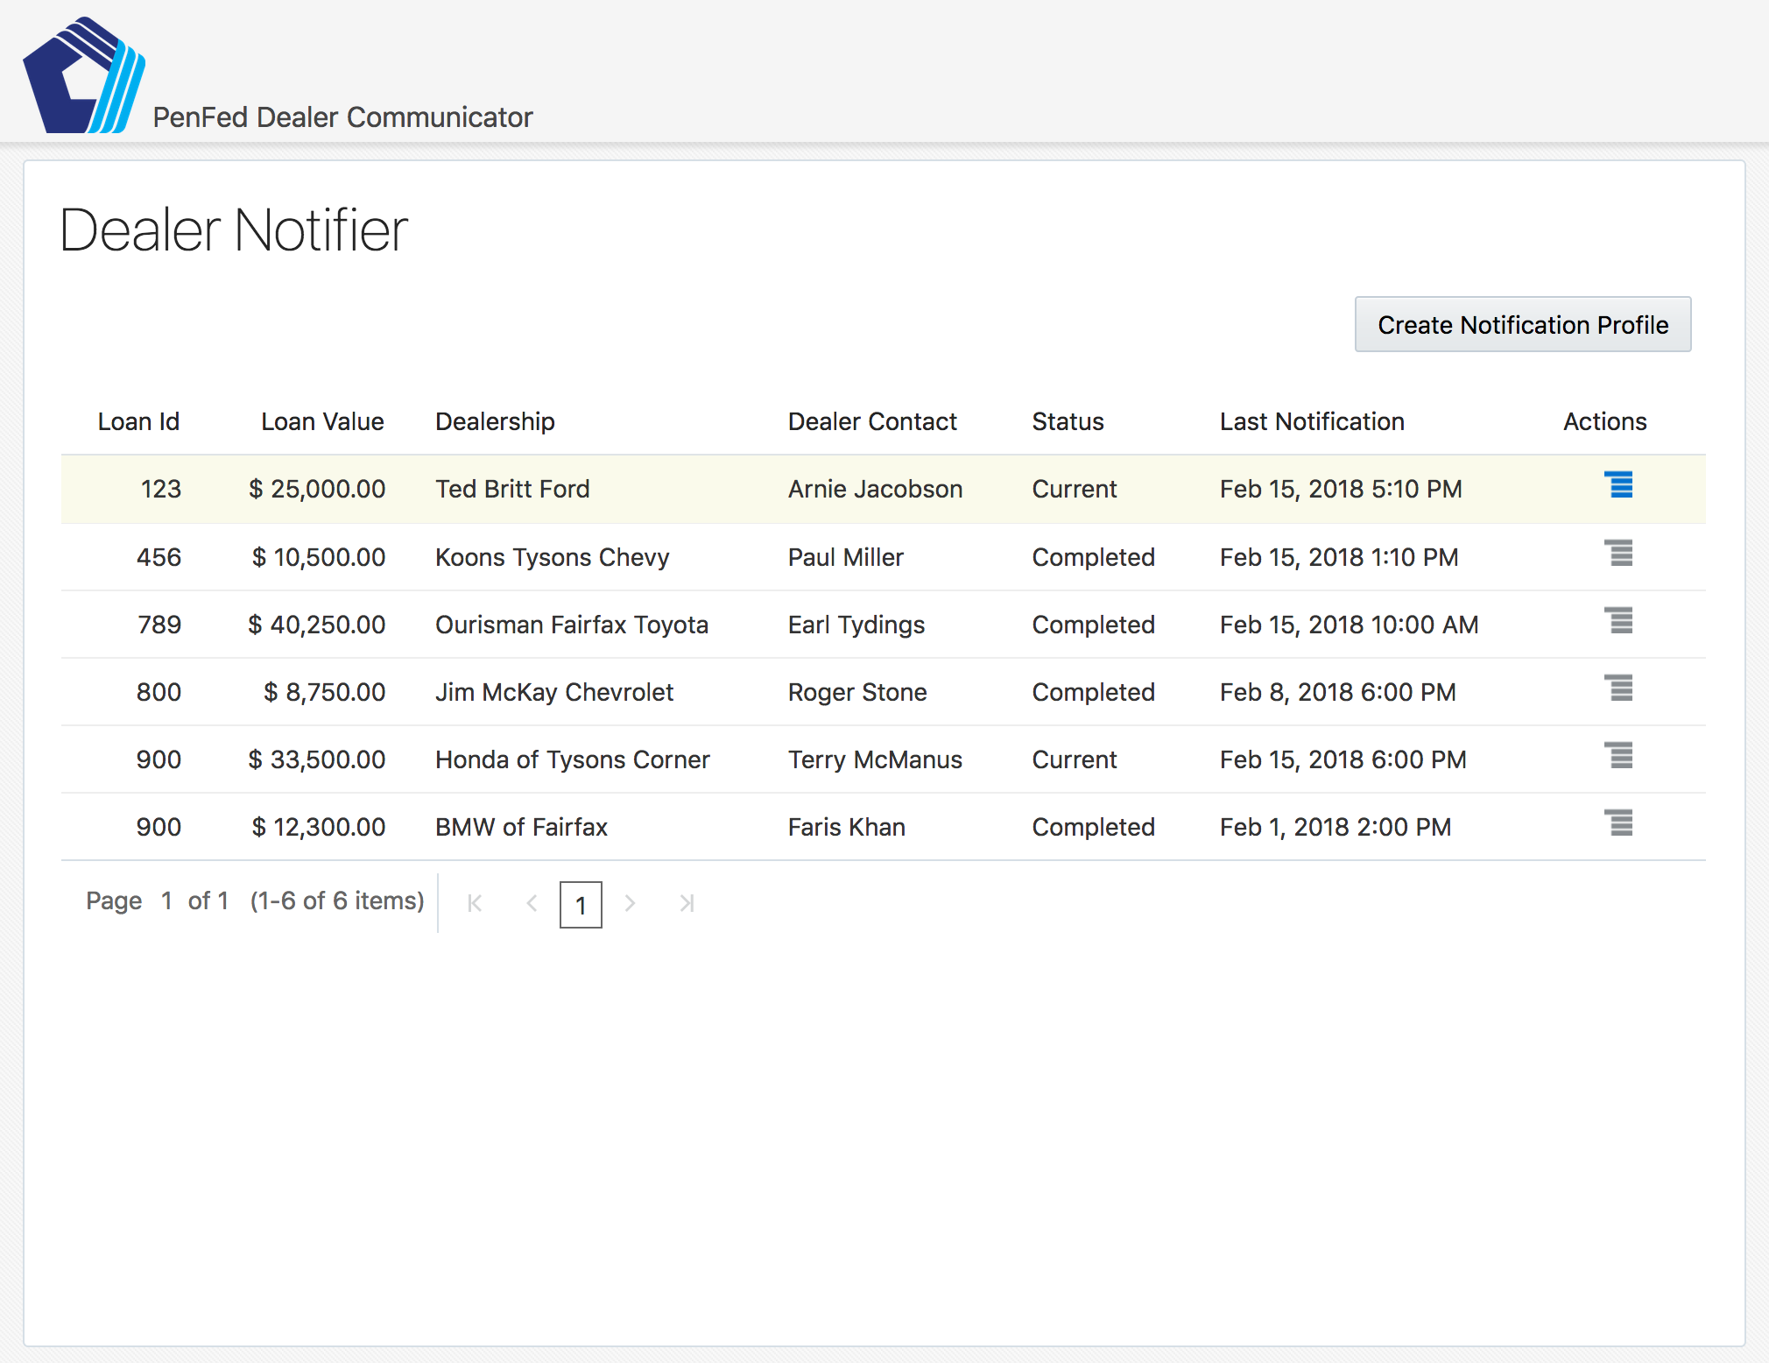
Step 1: Open the Dealer Notifier App
Every morning when logging into CUDL, the PenFed Loan Processor also opens the Dealer Notifier Application in their browser.
The app is tied into PenFed Single-Sign-On so logging in should be easy.
The Loan Processor will use this app to manage a side-band notification channel with dealers to help easily notify the dealer when messages have been posted into CUDL.
This same system will notify the PenFed Processor when messages are waiting from the dealer.

Slide 4
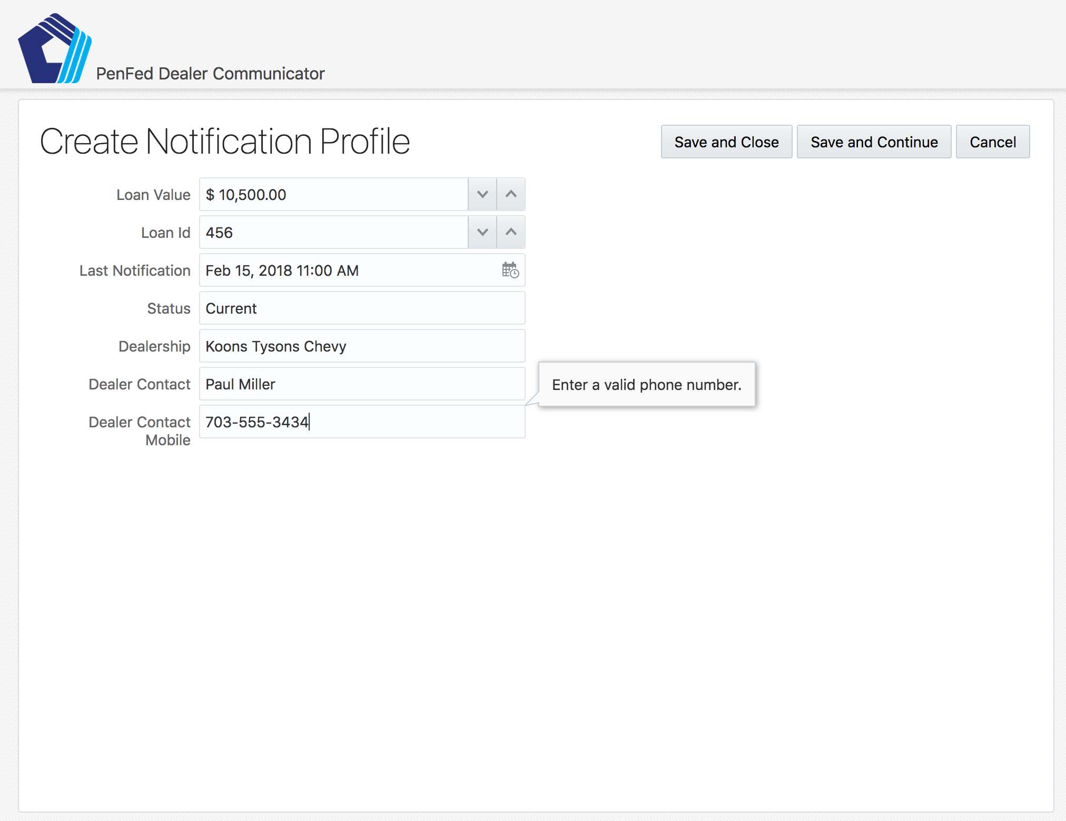
Step 2: Create a Notification Profile
When a new loan application comes into CUDL, the Loan Processor clicks Create Notification Profile on their Notifier Dashboard
This brings them into a creation screen which allows them to enter some key loan information along with contact information for the dealership and the F&I representative.
Performing this action triggers notification being sent to the F&I rep and a notification profile being created in the Dealer Notifier System.

Slide 5
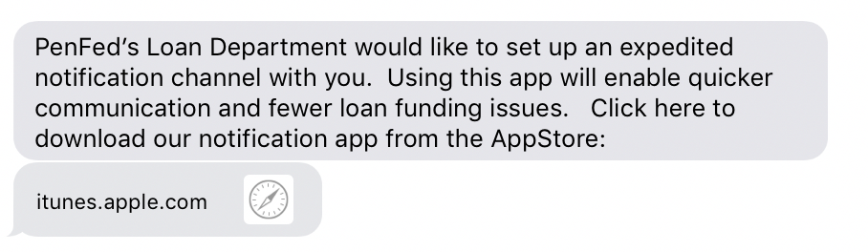
Step 3: Dealer F&I Contact Receives a Notification
If the dealer contact has already used this system, they will received a push notification in their PenFed Notifier App that a new loan application has been added.
If this is the first time PenFed is working with the dealer, an SMS (text message) will be sent to the dealer contact’s mobile inviting them to download the PenFed Notifyer App from the ITunes App Store or Google Play Store.

Slide 6
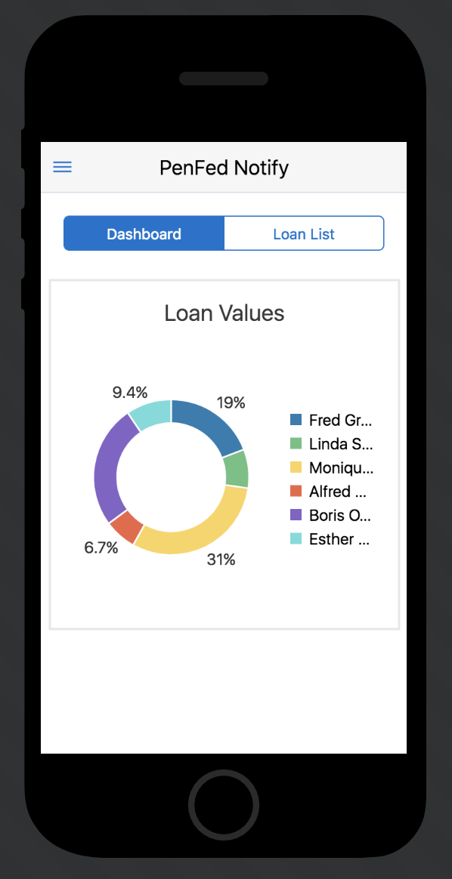
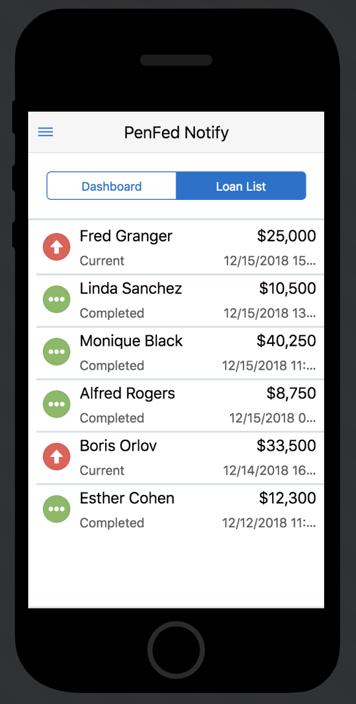
Step 4: Dealer Uses the App
The dealer now has a modern & attractive mobile app with PenFed branding that displays all of the loan application currently in-process between that dealer contact & PenFed.
The mobile app may show various graphs and charts on the dashboard as well provide a list of applications with information about the loanee, the value, the status of the application, and when the last message was sent.
The app can be configured to show in-process applications as well as ones which have been recently completed.

Slide 7
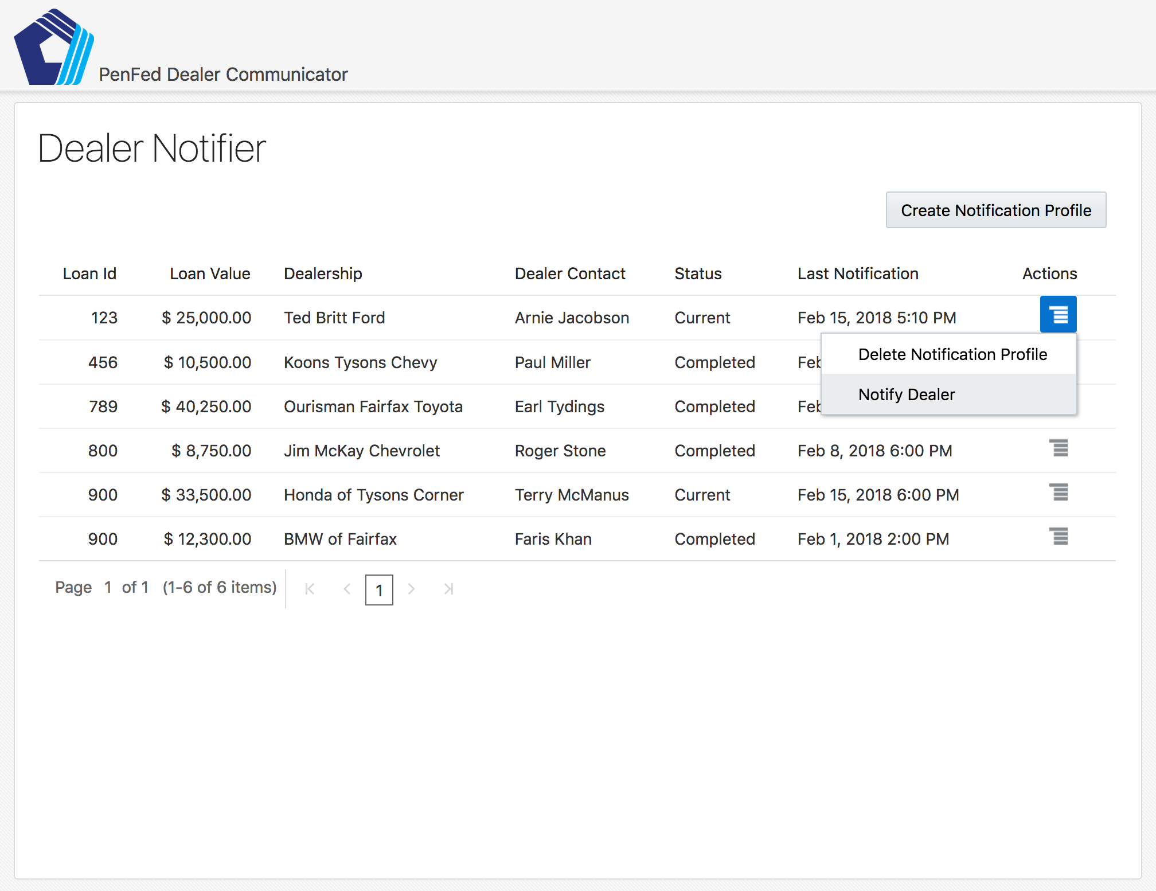
Step 5: Loan Processor Can Easily Notify Dealers
As the PenFed Loan Processor works through the loan process in CUDL, they are able to use the Notifier to quickly let the dealer contact know that a new message has been deposited in CUDL for them.
The Loan Processor simply clicks on the appropriate line item in their dashboard and selects Notify Dealer.
Performing this quick action triggers a push notification to be sent to the dealer’s phone driving them to open their mobile app.

Slide 8
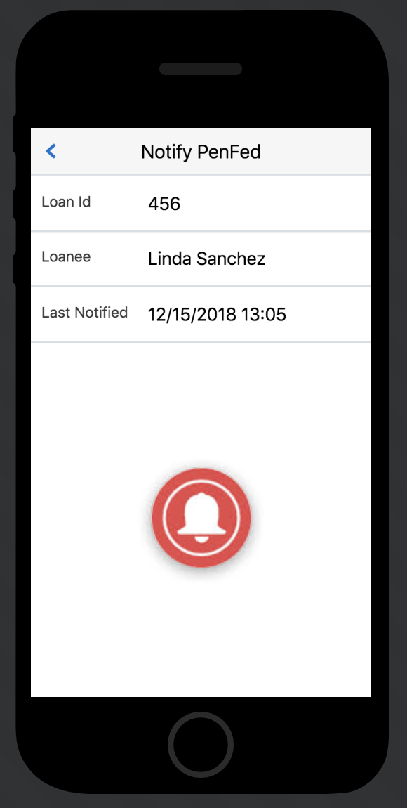
Step 6: Dealer Is Driven to Take Action
The dealer receives a notification on their phone that a new message is waiting in CUDL. The notification lets the dealer know which loan application the message is for.
If the dealer does not respond within a configurable period of time a reminder may be sent and this reminder may be repeated until the dealer contact takes action.
The dealer uses their mobile app to send a notification back to PenFed once they’ve entered their response into CUDL; sending the response is as easy as pressing the red NOTIFY button in their mobile app.
NOTIFY

Slide 9
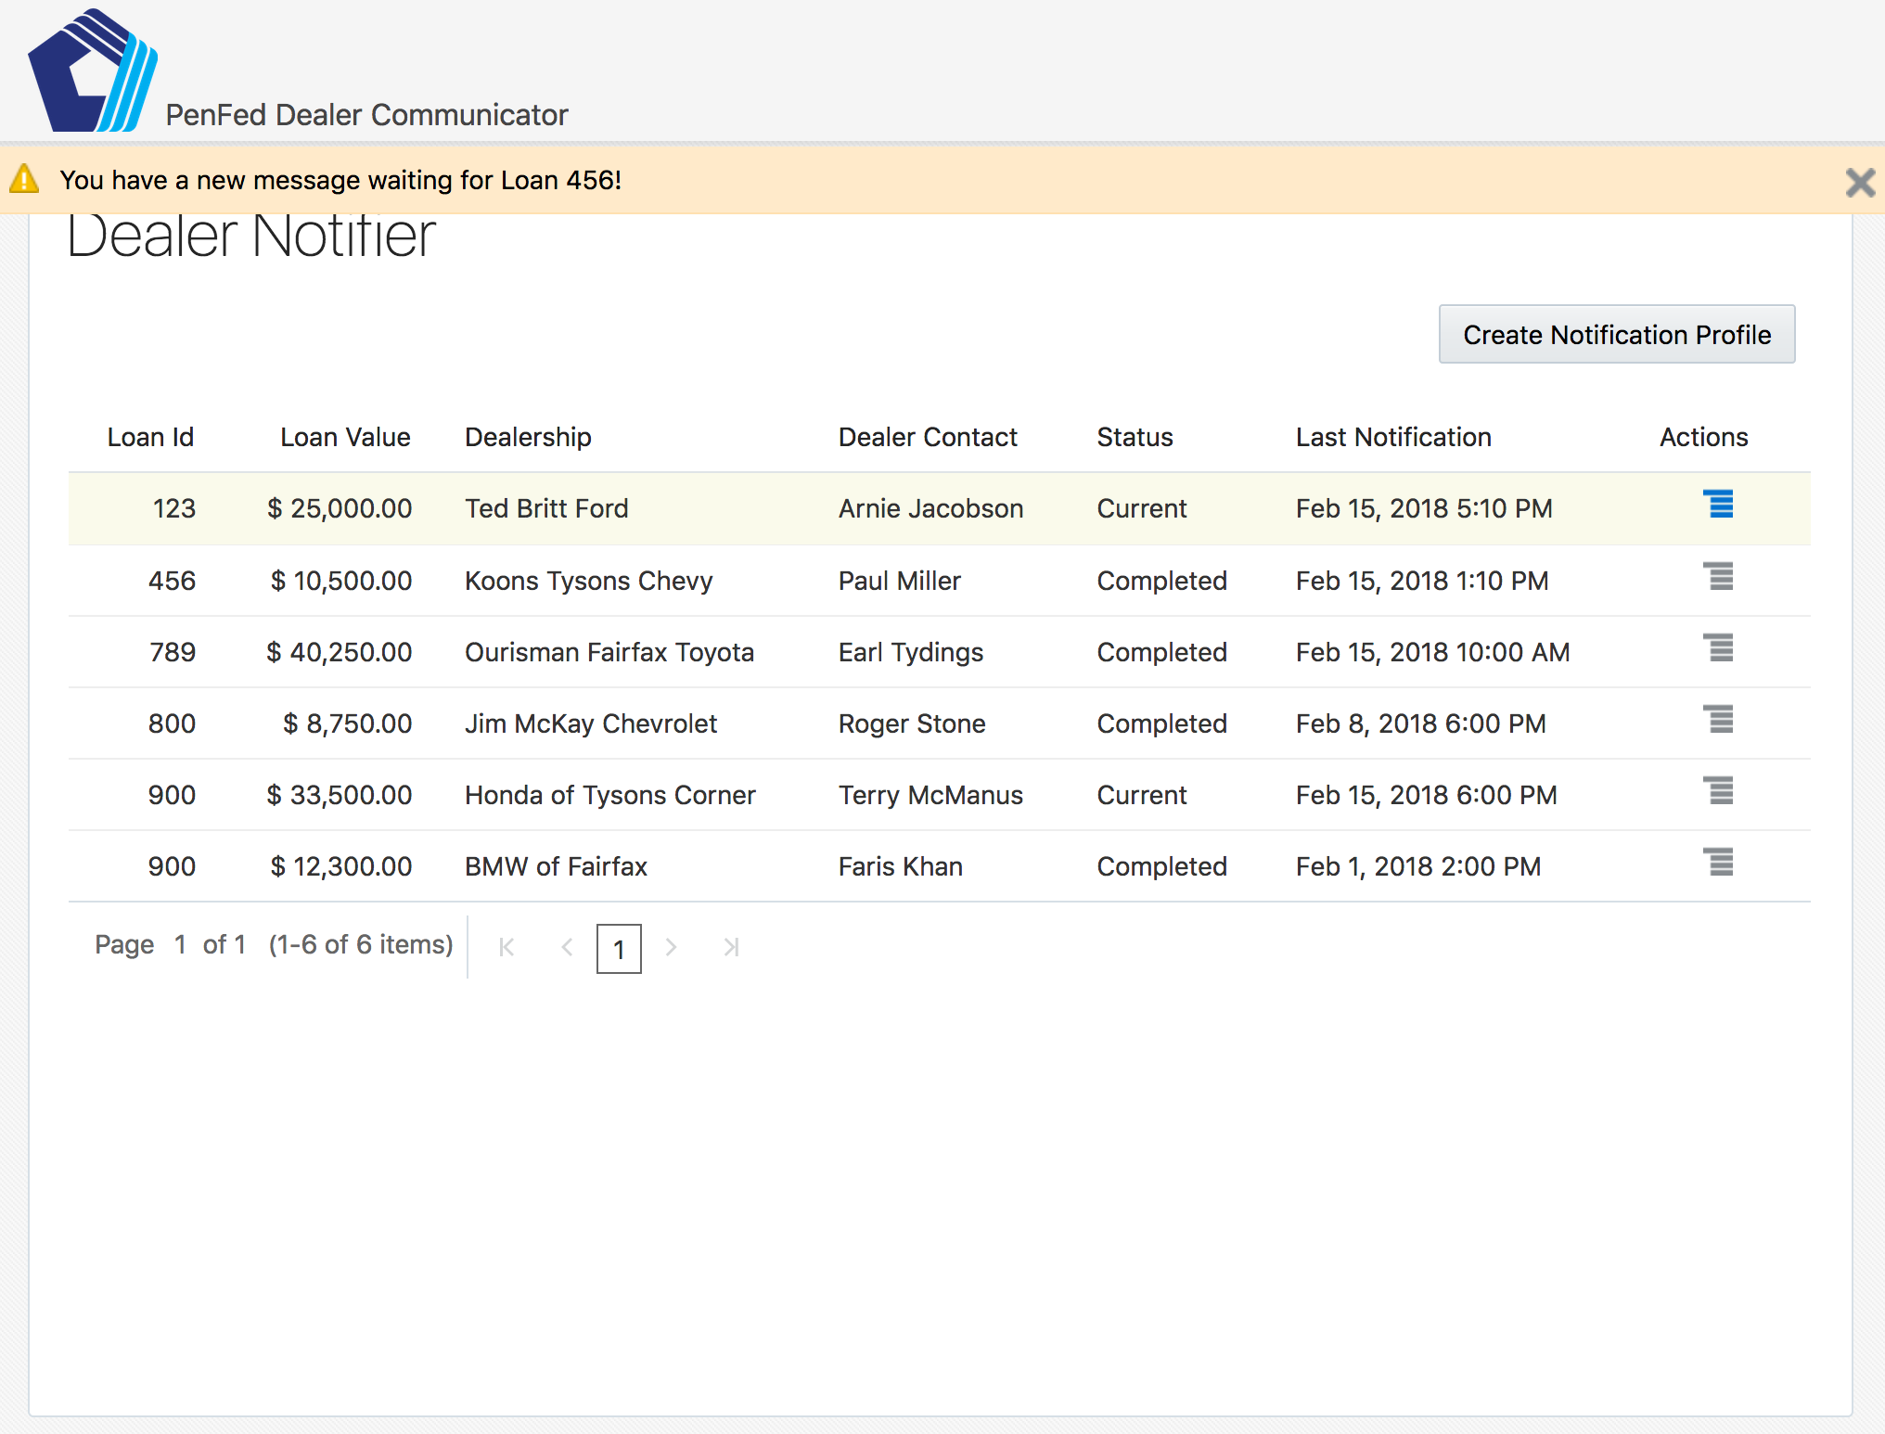
Step 7: Loan Processor Gets Dealer Notifications
The PenFed Loan Processor gets notified via an alert in their Notifier Dashboard as soon as a dealer contact has entered a new message.
Both mobile notifications and desktop notifications can also optionally be configured.
The Loan Processor now has immediate insight into when a new message has been added and can address the item quickly in the CUDL system.

